Slide 1
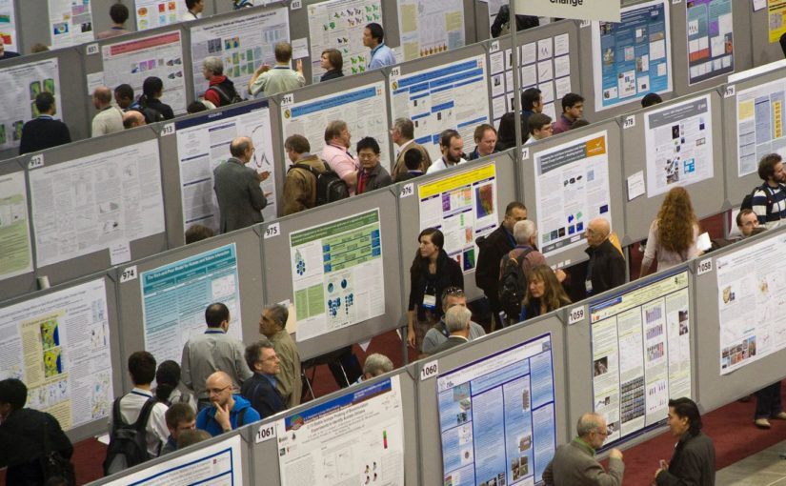
Poster presentation

Slide 2
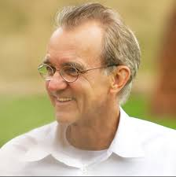
Tell the truth
Tailor presentation to the audience
Choose the right graphs
Emphasise important points
Form follows function

Slide 3
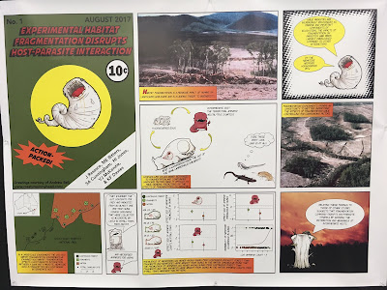

Poster presentation
What is your Story?
Nobody cares about your work.
Can you make them care?
Notes:
http://betterposters.blogspot.com/2017/08/

Slide 4




Level 1: At a Glance
Informative title
(maybe all that is read)
Readable at 1m
Engaging figures/pictures
No squinting at text
No confusing fonts
No Word Art
We found a thing!
First reports of results of studies into things
We are biologists!
LOTS of lovely images available

Slide 5
Level 2: More detail on examination
Make the data show the story with minimum reading
Each figure should be self sufficient,
Label on the figure if you can
Don’t bury important information in the figure legends
Do you even NEED figure legends?
Flow – obvious how to read through the poster
(not with numbers!)
Key points at eye level
Titles should be informative! NOT "results of the analysis"

Slide 6
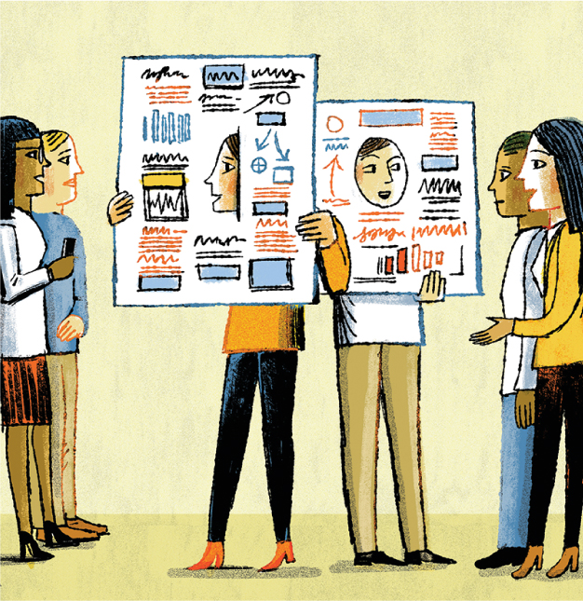
Level 3: Leads to Questions
What questions do you want the reader to be asking as they read your poster?
Set up discussion points
Is all the data you need to discuss visible on the poster?

Slide 7

Hopefully your data will tell the story it self
Keep text brief
Avoid paragraphs.
Avoid full sentences in favour of bullet points
You will be there
you can expand on points when talking to visitors

Slide 8
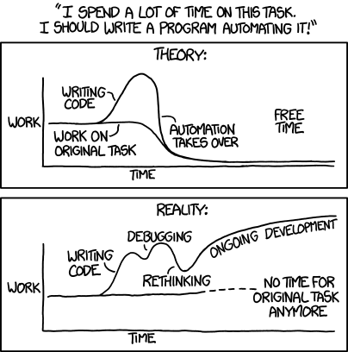
You WILL need to re-draw your figures. Make notebooks!

Slide 9

Don’t over interpret
you will have to justify what you’ve done in person!

Slide 10



http://betterposters.blogspot.com/
https://clauswilke.com/dataviz/
https://www.personal.psu.edu/drs18/postershow/

Slide 11
How can this poster be improved?
Put suggestions on the noteboard

Slide 13

One graph, one story!

Slide 14
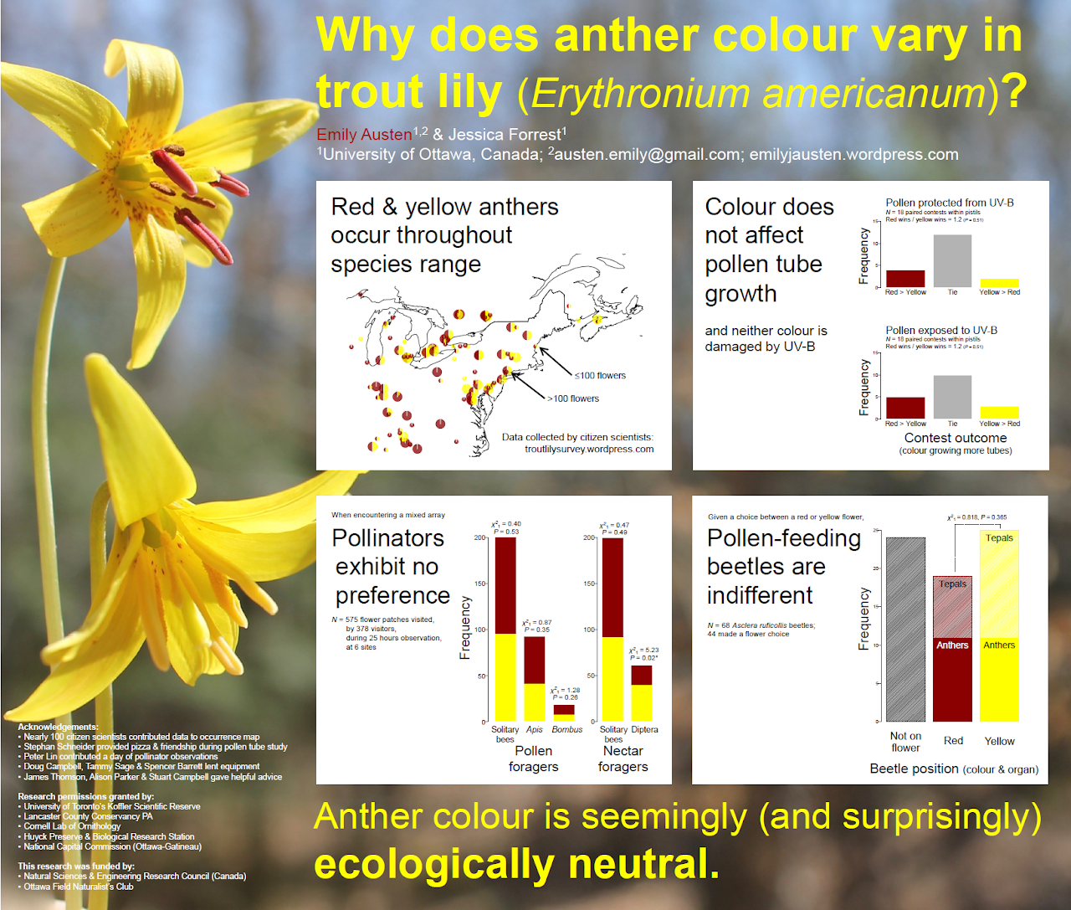
Question
Answer

Slide 15

Text to Shape

Slide 16
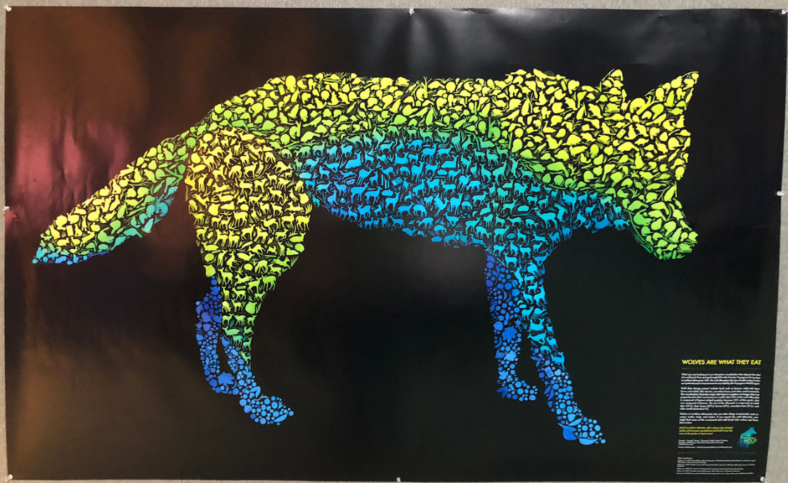
Images to Shape
Kimberly Boustead for Joseph K. Bump, Thomas D. Gable, Autin T. Homkes at Voyageurs Wolf Project.
The Wildlife Society conference, November 2022. #TWS2022 Photo by Trish Brockman.

Slide 17
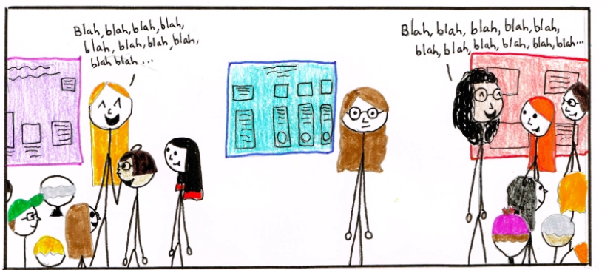
Useful advice on the practicalities of poster prep and how to manage a poster session:
https://www.science.org/content/article/how-prepare-scientific-poster
https://rubbishcomics.wordpress.com/2014/06/01/postersession/

